Slide 1
Ground rules
Sustainable
Our PPTs default mode is dark. Energy saved in every slide. Navigate through the bright cover slides and use the Knowit-black-background for everything else.
Accessible
Our columns are narrow and line lengths short for an easy, and accessible read
Keep it simple
Highlight only what strengthens your story. Leave everything else behind. And make every illustration count ☺

Slide 2
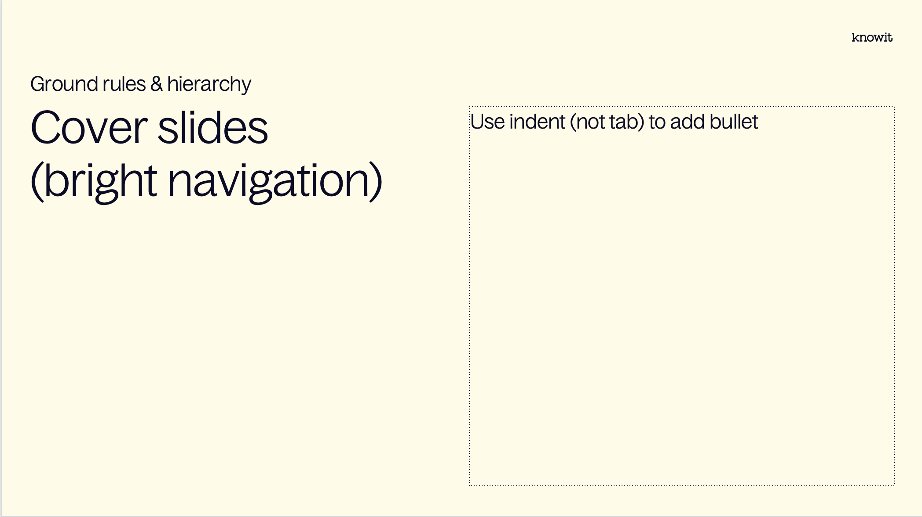
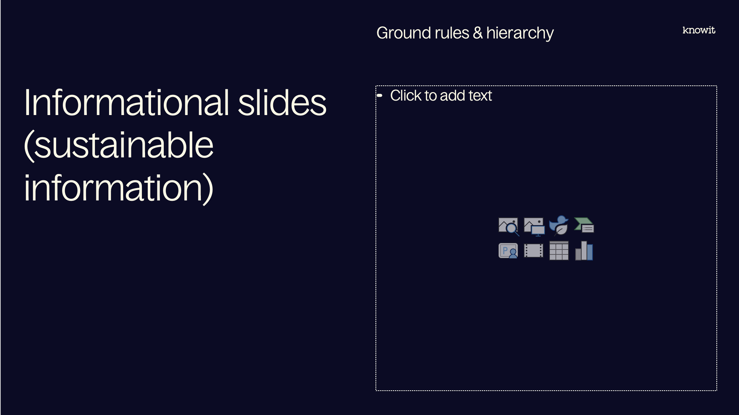
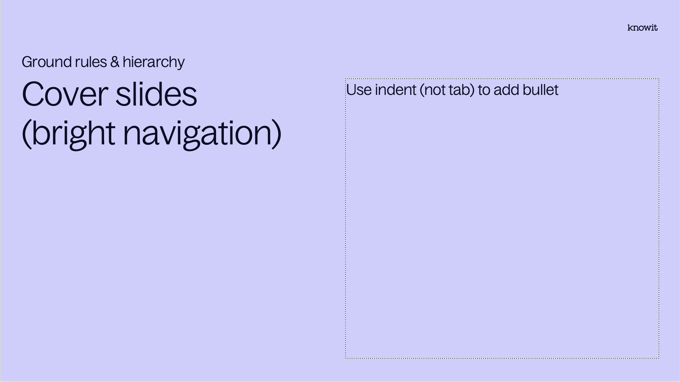
Visual prioritization

Slide 3
PowerPoint skills
Tips
Our template contains 38 different layouts, choose with care (and ask a colleague if you can’t find them)
The layout names might be helpful
Confused about colors or typographic rules? Check out the margins for some guidance
Have fun! (Break some rules if it helps you elevate your kick-ass-content☺)

Slide 5
Embedded academy Electronics and HW interfaces

Slide 6
Content
Introduction
Voltage dividers
Level shifters
Measurement
DAC and ADCs
Timers and Interrupts
Processor manual, deep dive

Slide 7
Lab
Introduction
In the lab today we will design a voltage divider and implement an ADC driver to read the voltage output from our voltage divider.

Slide 8
Notes from previous session

Slide 9
Reminder for today
Notes from previous sessions
Processor components
Bitwise operations
The processor manual

Slide 10
Voltage dividers

Slide 11

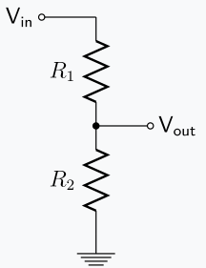
Voltage divider
Voltage divider
In practice a down-level shifter
Based on Kirchoffs voltage law (KVL)
Resistors in series are just a sum of the resistors
Usually done when measuring voltages, since processor have a limited measurement range
Can also be used to measure current by utilizing Ohms law U=R*I, or rather, I = U/R

Slide 12
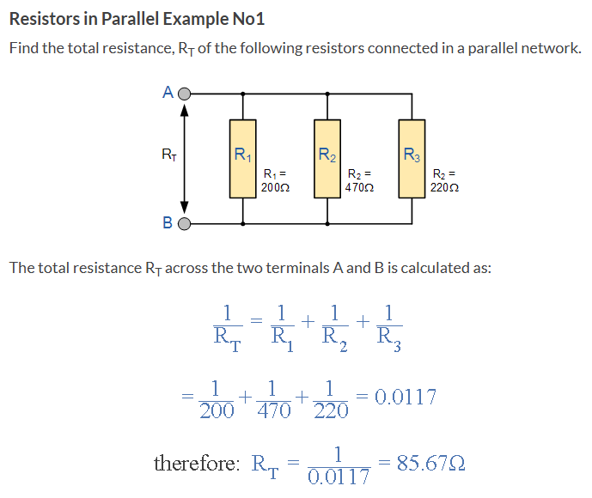
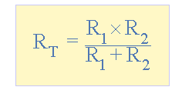
Parallel resistors
Voltage divider
A bit more cumbersome to calculate
Can be simplified as
If R1 = R2, RT = R1/2

Slide 13
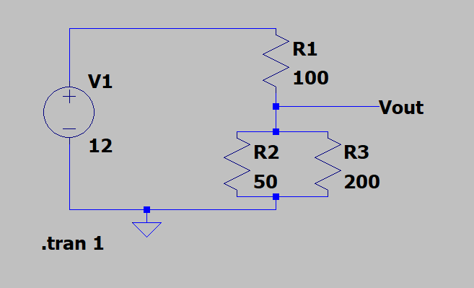
LTSpice
Voltage divider
Good tool to simplify calculations
R2||R3 = 50*200/(50+200)=40
Vout = R2||R3/(R1+R2||R3)*V1 = 40/(100+40)*12 = 3,42 V

Slide 14
Level shifter

Slide 15
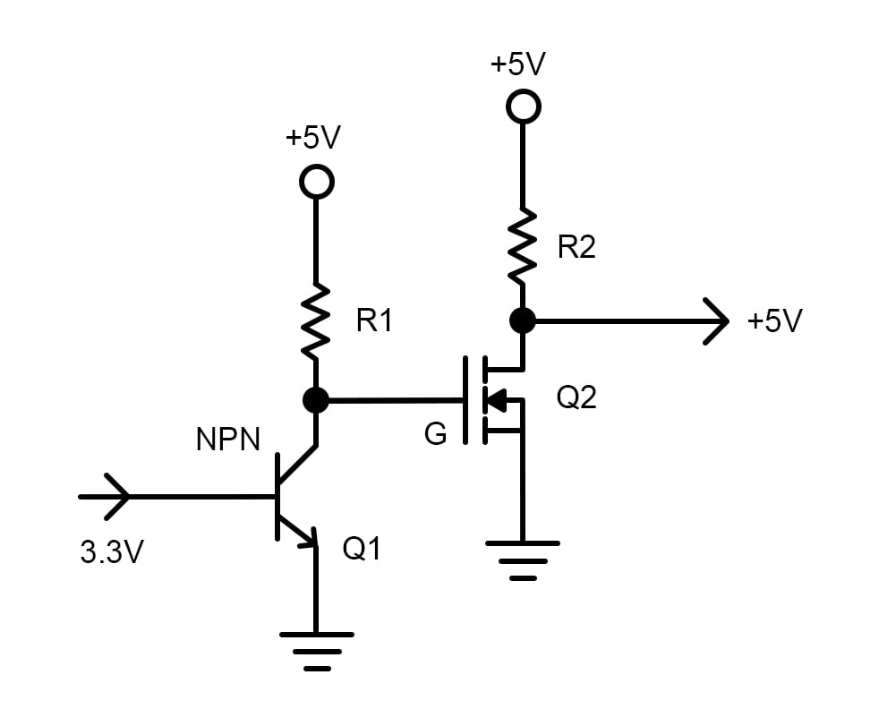
Level shifter
Level shifter
A microprocessor cannot drive high voltage outputs
By chaining transistors and MOSFETs, a higher voltage can be achieved

Slide 16
Measurement

Slide 17
Tools
Measurement
Oscilloscope
Multimeter
Logic analyzer
LCR meter

Slide 18
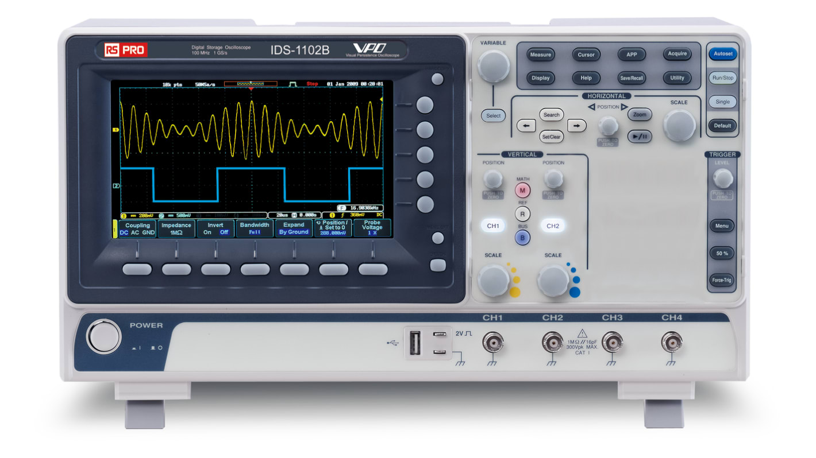
Oscilloscope
Measurement
Used to measure varying things
Can be set to trigger on certain events, either once or continuously
Can perform math operations, calculate frequencies, amplitudes etc.
Can measure really, really fast. Often several GHz.
Both described with GHz and GSa/s

Slide 19
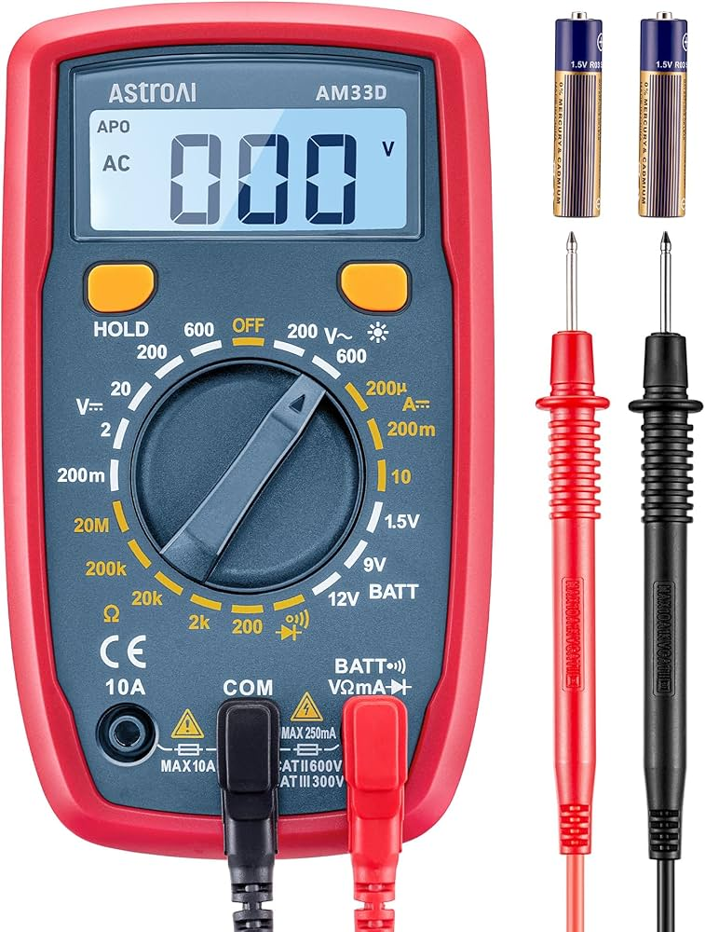
Multimeter
Measurement
Most basic electric measuring device
Can make rough measurements of voltage, current and resistance
Some are capable of measuring inductance and capacitance
Good for quick and easy measurements
Hard to measure low resistances

Slide 20
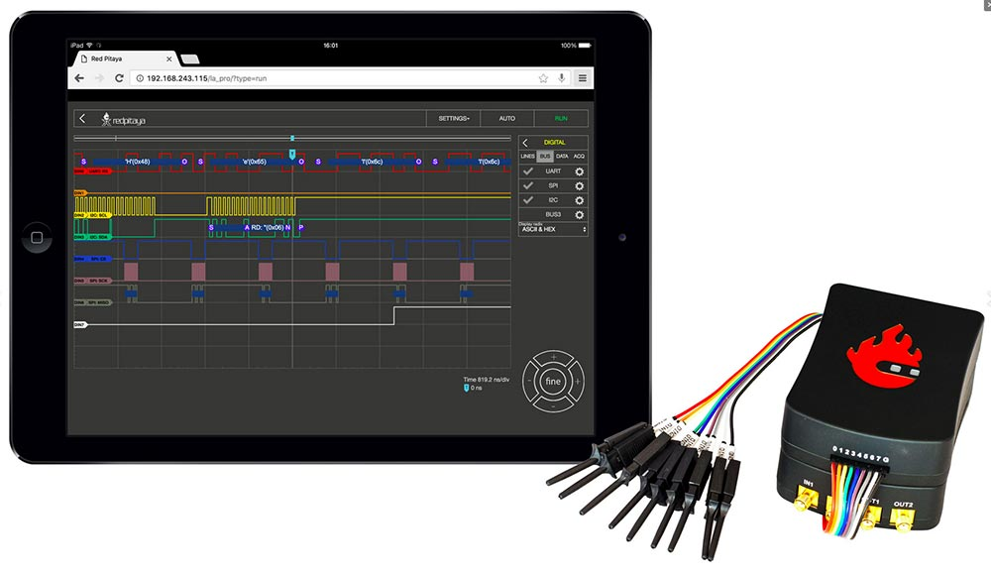
Logic analyzer
Measurement
Measure digital signals and digital communication buses
Usually connects to a software on your computer
Can decipher communication buses
Can be set up to trigger on special events
Sometimes capable of analog measurements, usual not with good resolution

Slide 21
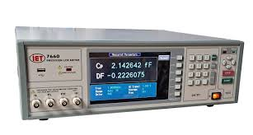
LCR meter
Measurement
Specialized device to measure inductance, capacitance and resistance
Very accurate measurements
Sensitive devices
Used when precision is necessary
Good for measuring inductance and capacitance

Slide 22
DAC and ADCs

Slide 23
DAC
DAC and ADCs
Digital-to-analog converter
Used for audio signals, mobile phones, resolvers etc.
Generates sinus waves, triangle waves, noise etc.
Varying capabilities pending on processor
Common with a specialized integrated circuit

Slide 24
ADC
DAC and ADCs
Analog-to-digital converter, opposite of DACs
Used to measure analog signals
Can be used with clever electronics to measure a lot of things
Everything is related to AD_REF, usually 3.3 V.
Resolution is determined in bits, 12 bit ADC is very common
2^12 = 4096, means a value of 4095 corresponds to 3.3 V. 2048 would then be 1.65 V
(AD_REF * AD_BITS) >> 12 corresponds to measure voltage
Could then use Ohms law to get current or invert the voltage divider to get actual voltage

Slide 25
DMA
DAC and ADCs
Direct memory access
Sometimes we sample faster than the code is executed, then DMA can be used
Stores samples in a buffer which then can be read all at once

Slide 26
Timers and interrupts

Slide 27
Timers
Timers and interrupts
Usually increments by one every clock cycle
Commonly 16 bits, meaning counting from 0 to 65535
Can have different prescalars (dividers) to achieve other lower resolutions
Can be configured to stop, restart or count down when reaching maximum
Interrupts can be triggered based on timers

Slide 28
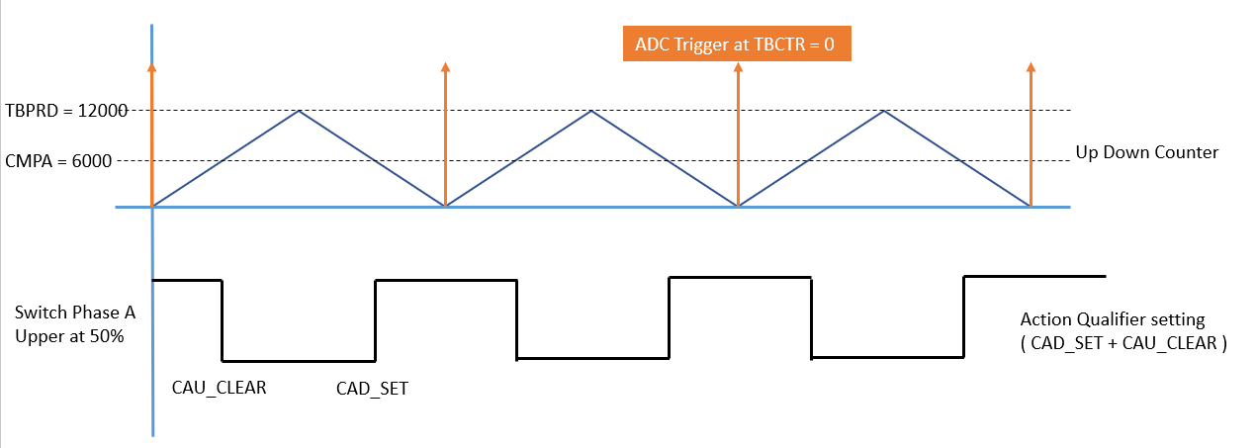
Interrupts
Timers and interrupts
A way for the peripherals to indicate to the software that something has happened
High priority
Can be based on a lot of things, ADC conversions, timers, external triggers
Try to minimize code during an interrupt

Slide 29
Processor manual

Slide 30
Parts of documentation
Processor manual
Reference manual
Application notes
Code examples

Slide 31
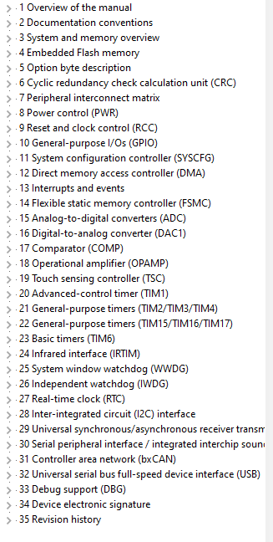
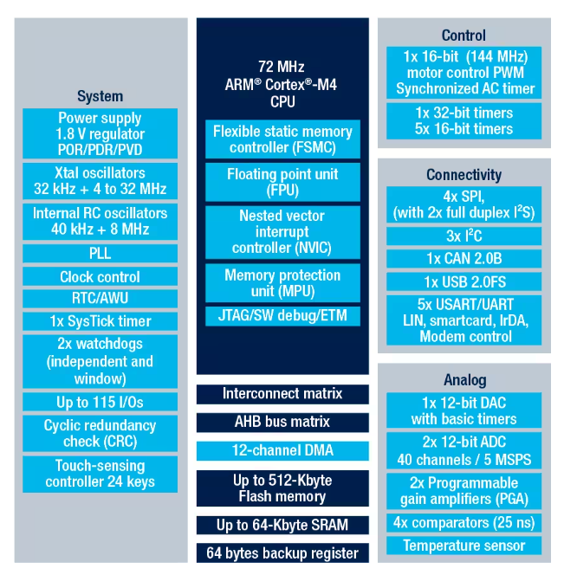
Overview
Processor manual

Slide 32
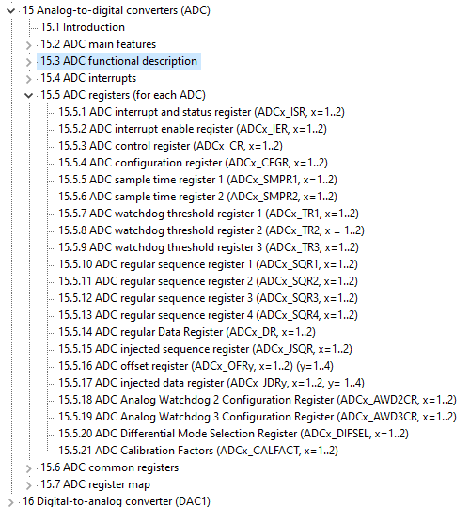
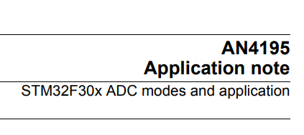
Overview
Processor manual
Lot of information in manual
Usually good help from Application Notes

Slide 33
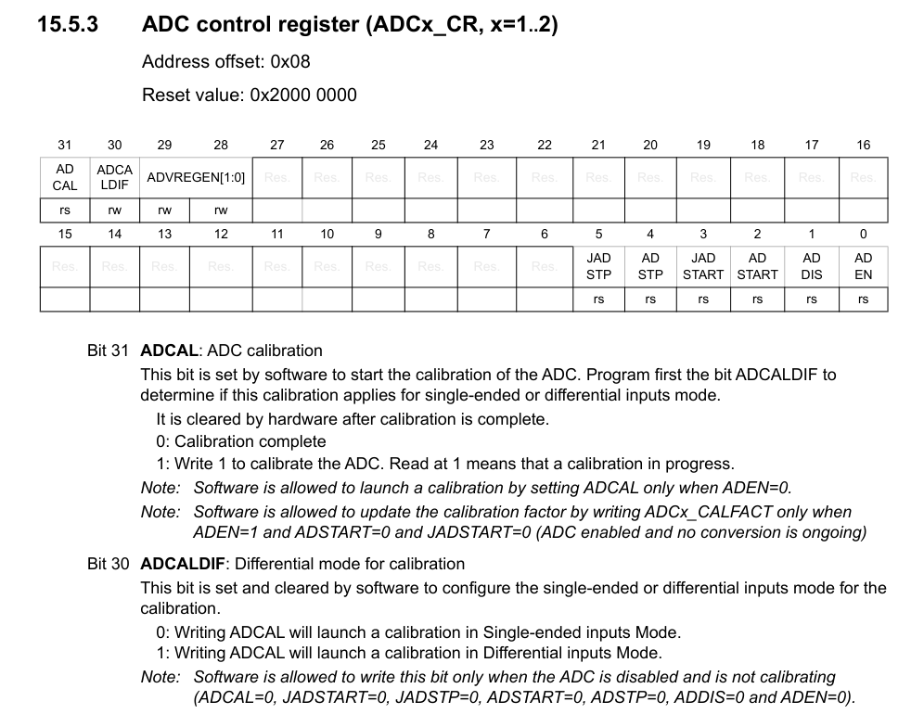
Register description
Processor manual
At the end of every chapter, there is usually a register overview.
Quite easy way to get a view of whats going on

Slide 34
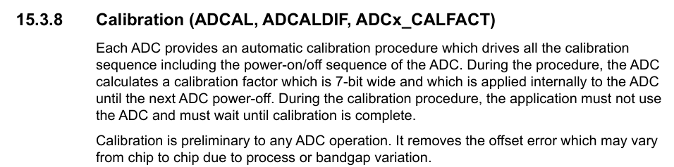
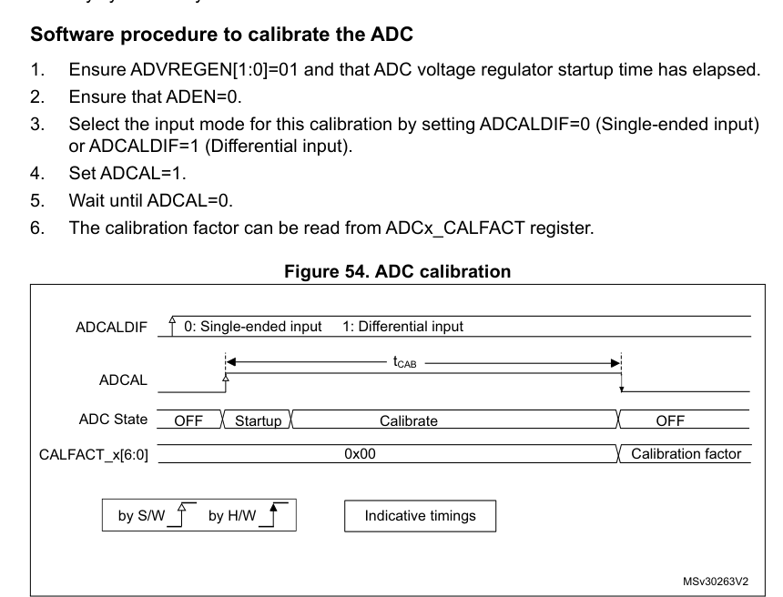
Functional description
Processor manual
Parts of register often have their own sections with more description
Combine with internet searches

Slide 35
Writing to registers
Processor manual
Use bitwise operations
Setting bits
register |= (1 u<< bitposition);
Clearing bits
register &= (~(1 u<< bitposition));

Slide 36
Questions?

Slide 37
Lab part

Slide 38
Lab
Introduction
In the lab today we will design a voltage divider and implement an ADC driver to read the voltage output from our voltage divider.

Slide 39












































































Our icons

Slide 40

















UN SDG (PNG)

Slide 41

















UN SDG (SVG)

